Slide 1
Americans with Disabilities Act
(ADA)
Youth Training
February 28, 2018
Rene Cummins
Yolanda Vargas

Slide 2
What is a reasonable accommodation?
Drop your answer in the chat box

Slide 3
Training Outline
This is a seven week training covering the Americans with Disabilities Act.
February 14, 2018
  Overview of the ADA
  Disability Disclosure (1st Key)
February 28, 2018
  Overview of Title 1
  Reasonable Accommodations (2nd Key)
March 14, 2018
  Requesting an Accommodations
  (3rd Key)
March 28, 2018
  Overview of Title II- State and Local Government
  3 Keys
April 11, 2018
  Transportation
April 18, 2018
  Overview of Title III-Private Entity
  3 Keys
May 9, 2018
  Overview of Title IV-Telecommunication
  Overview of Title V-Miscellaneous Provisions
  3 Keys
  Review

Slide 4

What does disability mean to you?

Slide 5
Overview of ADA
Title I-Employment
  Public Entities State and Local Government
    1 or more employees
  Private Employers and 15 employees

Slide 6

2nd Key-Reasonable Accommodations
What is a reasonable accommodation
  What are your answers?
  Lets learn more!

Slide 7
Reasonable Accommodations
When do you request?
  Application
  Interview
  Initial Job Offer
  On the Job

Slide 8
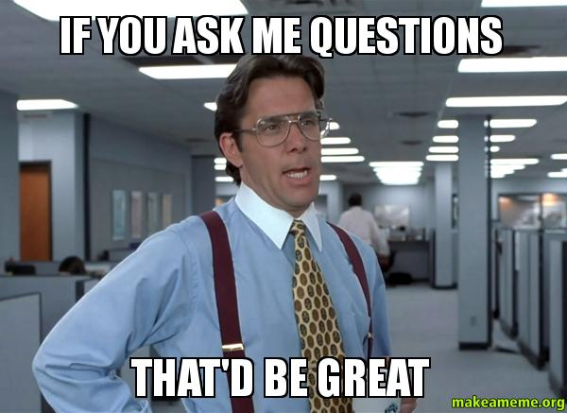
Q&A

Slide 9

Fortune Teller
Pick a color
  Red, Blue, Green, Pink
Pick a number
  Application
  Interview
  Initial Job Offer
  On the Job
Answer the question?

Slide 10

Processing

Slide 11
Wrap Up
Next Training date
  March 14, 2018 from 4:00-5:00pm(EST) (3:00-4:00pm CST, 2:00-3:00pm MST, 1:00-2:00pm PST)
  How do you Request an Accommodation?
    Pick one of the 4 areas and request an accommodation you may need in this area?

