Slide 1
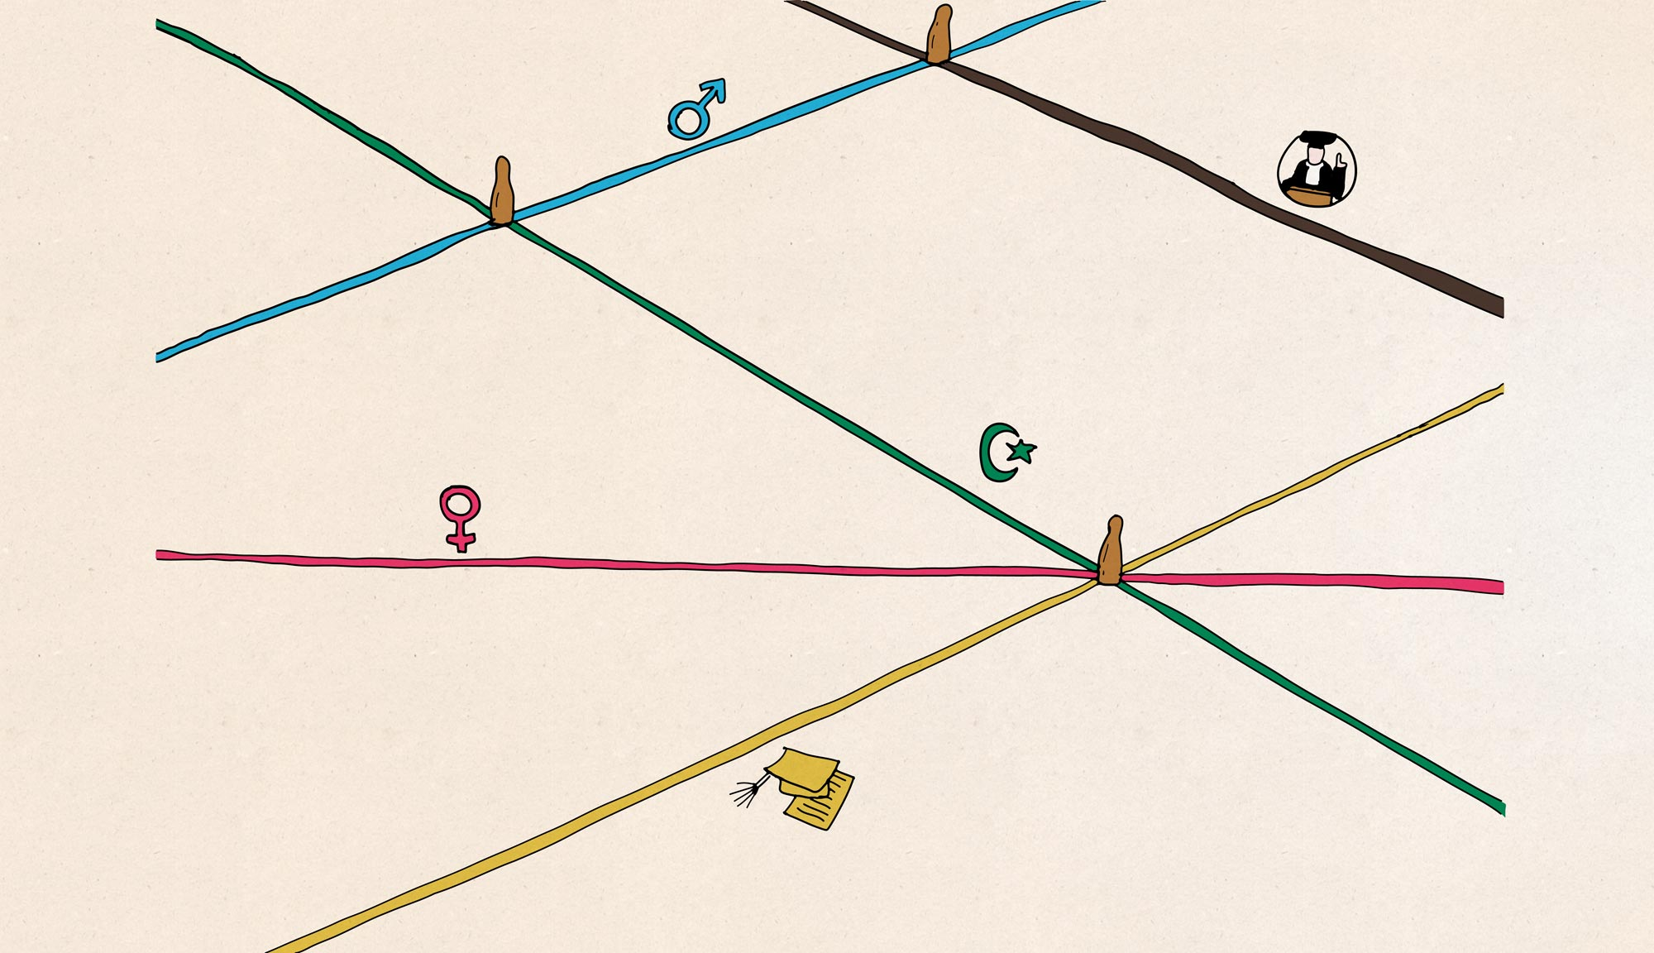
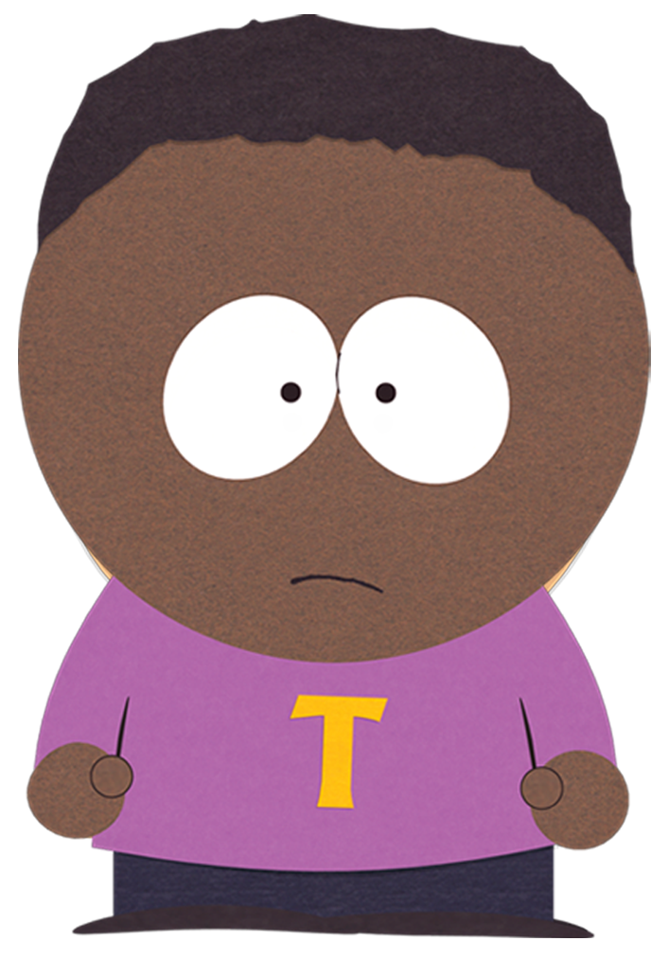
REDEEMING YOUR TOKEN
Dustin Gibson & Sukie Glick

Slide 2


#DISABILITYSOLIDARITY
Dustin Gibson: @notthreefifths Sukie Glick: @disABILITYLINK

Slide 3
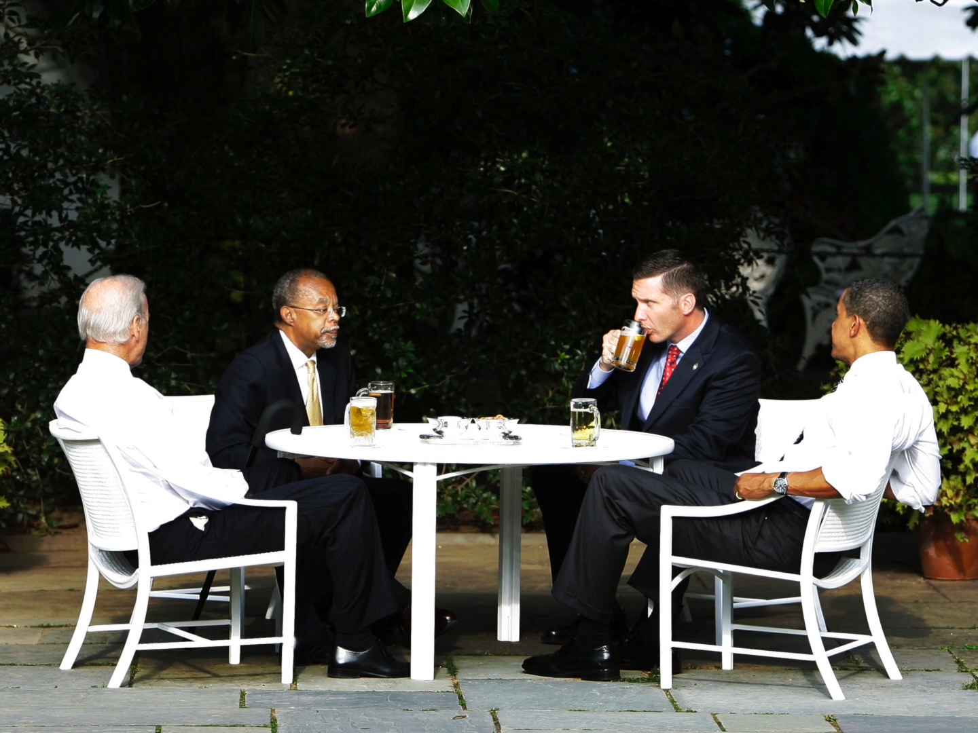
START THE CONVERSATION
Vice President Joe Biden, Harvard professor Henry Louis Gates, Jr., Cambridge police Sergeant James Crowley, and President Obama having a conversation during the “Beer Summit”.

Slide 4

GUIDELINES
MOVE UP, MOVE BACK
  Be conscious of the space we take up, make room for everyone in the conversation
ONE MIC
  One person sharing at a time.
RESPECT
EYE STATEMENTS
  Use personal experiences
SAFE SPACE
  Stories don’t leave the room, but information does
SUPPORT EACH OTHER
  Support, not taking care of
POWER DYNAMICS
  Understanding the privileges we hold in the space
LITERACY MOMENT
  Let us know if you don’t know a concept or term
ACCESSIBILITY
ACCOUNTABILITY
  Checks

Slide 5
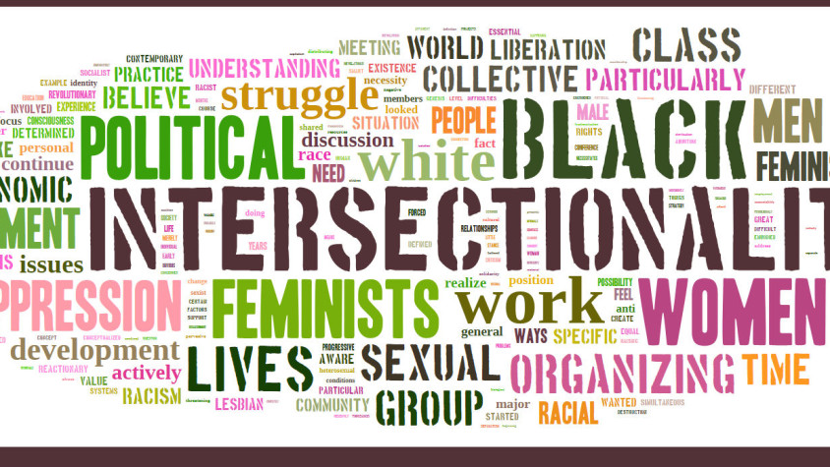
VOCABULARY TOOLS
Power, privilege, oppression, race, ethnicity, identity, gender, sexual orientation and class.

Slide 6
POWER
The ability to decide who will access to resources; the capacity to direct or influence the behavior of others, oneself, and/or the course of events.

Slide 7
PRIVILEGE
Unearned access to resources only readily available to some people as a result of their advantaged social group membership.

Slide 8
OPPRESSION
A system that maintains advantage and disadvantage based on social group memberships and operates, intentionally and unintentionally, on individual, institutional, and cultural levels.

Slide 9
RACE
A socio-historical category used to divide people into populations or groups based on physical appearance, such as skin color, eye color, hair color, etc.

Slide 10
OPPRESSION
A system that maintains advantage and disadvantage based on social group memberships and operates, intentionally and unintentionally, on individual, institutional, and cultural levels.

Slide 11
ETHNICITY
A category that describes membership to a group based on real or presumed common ancestry, shared languages and/or religious beliefs, cultural heritage and group history.

Slide 12
IDENTITY
The system of ordering a society in which people are divided into sets based on perceived social or economic status.

Slide 13
GENDER
A social identity used interchangeably with biological sex in a system that presumes if one has male characteristics, one is male, and if one has female characteristics, one is female.

Slide 14
SEXUAL ORIENTATION
One’s natural preference in sexual and/or romantic partners.

Slide 15
CLASS
The system of ordering a society in which people are divided into sets based on perceived social or economic status.

Slide 16
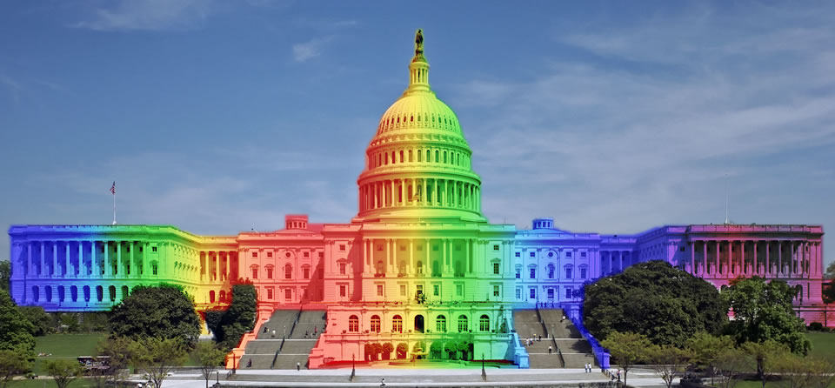
SYSTEM
A set of principles or procedures according to which something is done; an organized scheme or method.

Slide 17
THE “-ISMS”
ABLESIM
RACISM
In 2008, only 27% of polling places were fully accessible
“If a white man wants to lynch me, that’s his problem. If he’s got the power to lynch me, that’s my problem. Racism is not a question of attitude; it’s a question of power.” – Stokely Carmichael

Slide 18
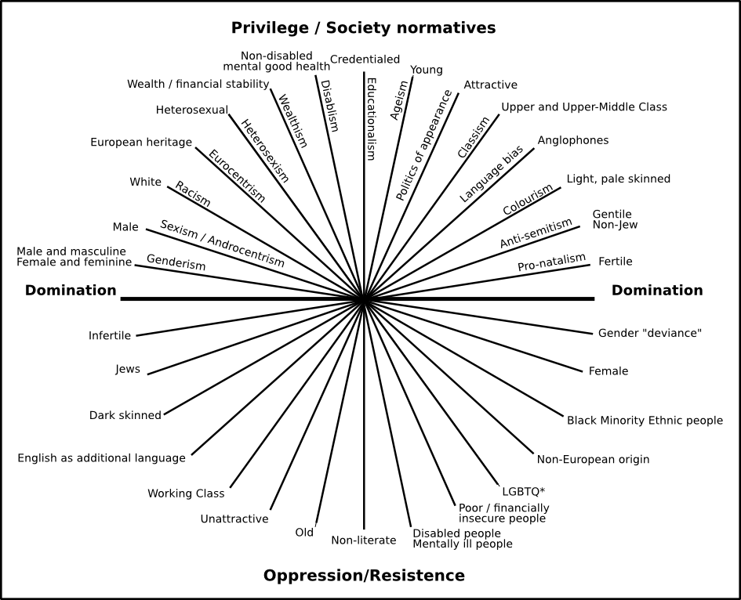

Slide 19
INTERSECTIONALITY
“There is no such thing as a single issue struggle because we do not live single issue lives.”
– Audre Lorde

Slide 20
Connect all of the dots, using only 4 lines, without stopping

Slide 22
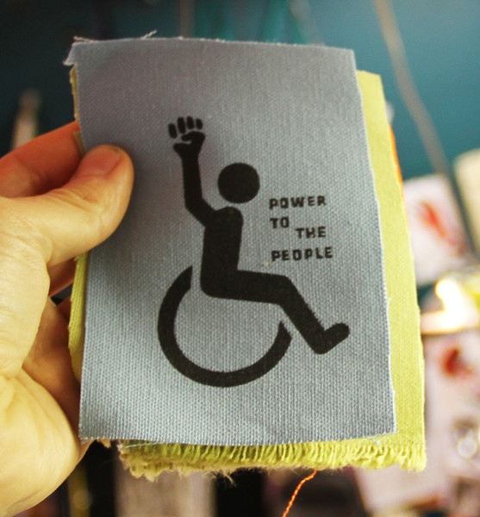
WHAT CAN CIL’S DO?
Signage
History
Current Events
Peer to Peer
BLM Philosophy
In-House
Hiring, volunteer outreach, board, trainings
Community Connections

Slide 23
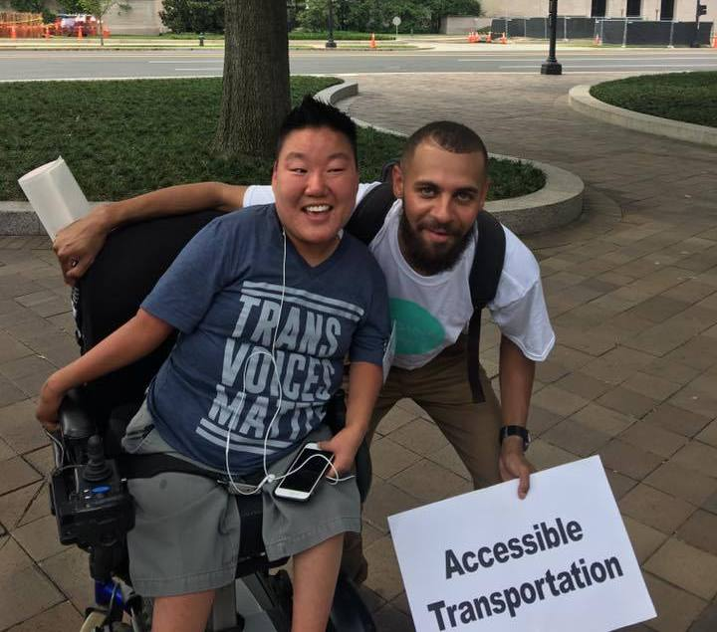
CONTACT INFO
Dustin Gibson
@notthreefifths
dustinpgibsosn@gmail.com
Sukie Glick
sglick@disabilitylink.org

