Slide 1

Getting involved in the Emergency Management world
Jerry Riener
Program Specialist

Slide 2
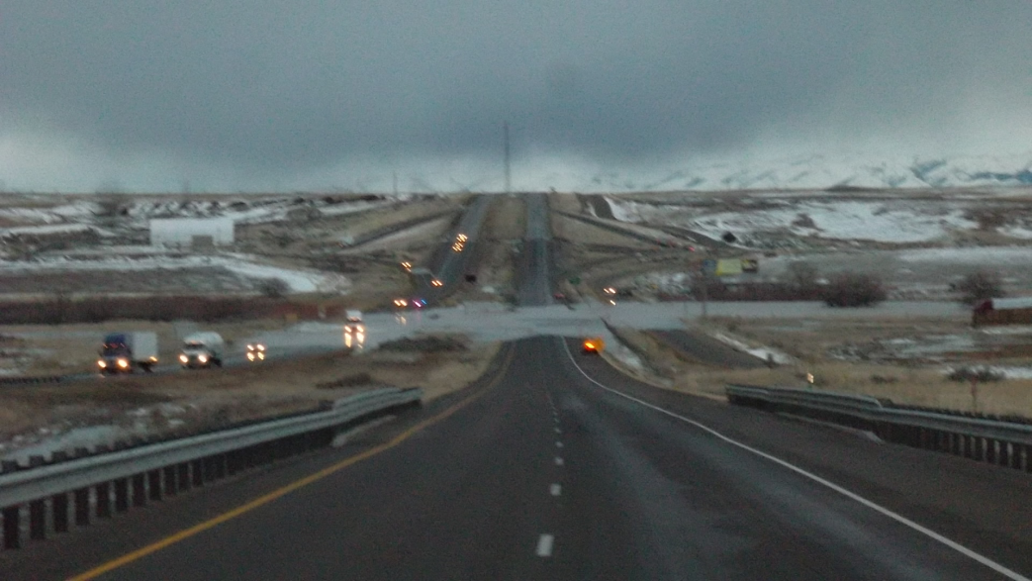
Introduction
Idaho had a busy year
  Massive snowfall, followed by rain and flooding
    17 counties were 150% above average (5 were up to 300%) for snowfall
  Mudslides
    10 counties had major mudslides
Federally declared disasters in 22 out of 44 counties in Idaho
Photo description: four lane, divided freeway running down the center with a large dip in the road which is covered by a river flooding across it. Vehicles with lights on are stopped on either side of the water. Part of the landscape is covered in snow with mountains in the background.

Slide 3
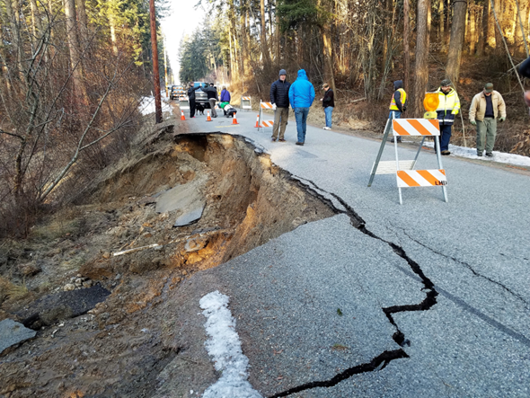
What we will cover
  The importance of a clear and concise agency purpose
  Who to get involved with and how to do it
  5 core lessons learned
Photo description: a highway through a forested area with people dressed for winter walking and standing, looking at road damage. There are traffic cones on the roadway, blocking off the left side of the road which has fallen off with pieces of broken asphalt scattered around. Old snow can be seen in varied degrees of melt on the sides of the road.

Slide 4
4 phases of emergency management
Mitigation
  Preventing future emergencies or minimizing their effects
Preparedness
  Preparing to handle an emergency
Response
  Responding safely to an emergency
Recovery
  Recovering from an emergency

Slide 5

Purpose
Establish it early
  Sets clear expectations for you and your organization
  Gives the organizations with whom you are working with a clear understanding of what you bring to the table
Graphic description: the word DANGER, surrounded by a red oval with a black background sits above the word EXPECTATIONS with a white background.

Slide 6
Considerations when determining your purpose
How you will fit into the emergency management world?
What can you offer?
  Technical assistance?
  Assistive technology?
  Medical goods?
Your time commitments?
  Be realistic

Slide 7
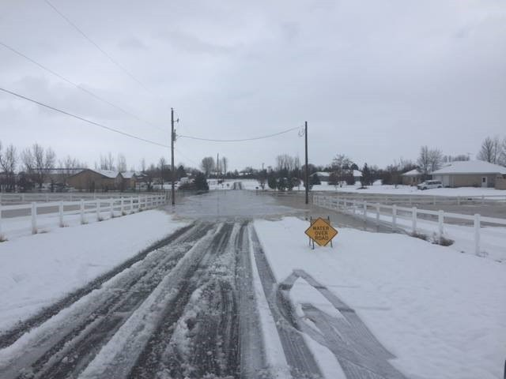
How to get involved
Understand your role within the framework
Go to meetings and training opportunities
Encourage others to participate
Photo description: a snow and ice covered road with a yellow traffic sign on the right side. The sky is grey and cloudy. Water covers the back half of the road. Telephone poles and white fences flank either side of the road.

Slide 8

Who
Office of Emergency Management
VOAD(Volunteers Organizations Active in Disaster)
Graphic description: within a circle, a blue Idaho shape outline on a greyish–gold background, with the words “Prevention, Protection, Mitigation, Response,” and “Recovery” in white letters overlaid on the Idaho shape. Surround by red border with the words “IDAHO OFFICE OF EMERGENCY MANAGEMENT” at the top and “IDAHO’S HOMELAND SECURITY & EMERGENCY MANAGEMENT AGENCY” in the bottom of the red band. All on a white square background

Slide 9


Graphic description: a horizontal rectangle with four separate pictures side by side. The first photo is of green rolling hills with an white outline of Idaho over it. The second photo is of a rocky canyon with red rocks, the third photo is of a tall sand dune and the last is a flower field with yellow and pink flowers outlined by a cloudy sky. The words in yellow, “Preparedness and Response” stretch across all four photos.
Department of Health and Welfare Preparedness Programs
Graphic Description: a rectangle blue graphic with the words ADA COUNTY ACEM EMERGENCY MANAGEMENT in it. On the left side are 3 gold stars.
Local Emergency Managers

Slide 10

Lesson 1 purpose is clear and concise
Helps the emergency management world and how they will interact with you
Allows you to engage with more confidence
Helps you develop a plan of action
Graphic description: A black rectangle with white lettering in the middle that says “got purpose?”

Slide 11

Lesson 2
Resistance
Its going to happen
Invitations to the trainings/exercises
Department of Health and Welfare
  Thought they were the experts
To the concept of Independent Living
Photo description: a yellow, diamond shaped road sign with a blue sky background. The road sign says in black, bold lettering, “RESISTANCE AHEAD.”

Slide 12

Lesson 3
Don’t allow yourself to be that “Checked” box
Being pushed into being a case manager for people with disabilities
Not having any regulatory or pushback authority within other agencies
Graphic description: a white rectangle with a black box in the center that has a blue checkmark in it.

Slide 13
Lesson 4
Over-Taxing/Pacing yourself
Before an emergency
  Outreach needs to be done
During an emergency
  Know your limits
During the recovery
  Stretching your resources thin

Slide 14
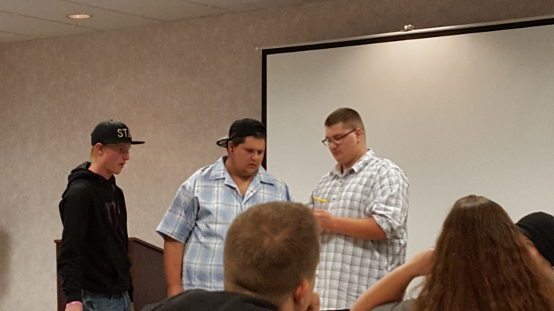
Lesson 5
Strong and established Grassroots
To help with meeting and training attendance – the community must be present and active
To ease risk of burnout or becoming overextended
Photo description: three young men, one wearing a black sweatshirt and ball cap, one in white and blue plaid button down shirt with backwards ball cap and one in a brown and white checkered shirt, wearing glasses. The back of people heads are in the forefront, with a white movie screen in the background. The young men are demonstrating some home preparedness tips in a workshop setting.

Slide 15
Questions?
Jerry Riener
Program Specialist
Idaho State Independent Living Council
380 South 4th Street, Ste. 102
Boise, ID 83702
Phone: 208-334-3800
Toll-Free: 1-800-487-4866
Fax: 208-334-3803
Email: jerry.riener@silc.idaho.gov
http://www.silc.idaho.gov

