Slide 1
Who are we?
Rural CIL with 8 counties that cover 3,903 square miles.
Population is 366,745 with a disability rate of 24%

Slide 2
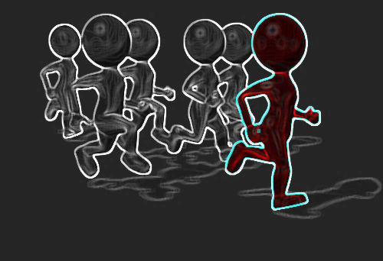
Youth Transitions: The Secret to Getting Ahead is Getting Started.
Expanding CIL Capacity with Youth Transition Services

Slide 3

Youth Transitions
CIL’s are to aid in facilitating the transition of youth who are individuals with significant disabilities who are eligible for individualized education programs, and who have or will complete their secondary education or otherwise left school, to postsecondary life.
It’s my

Slide 4

Where do CIL’s fit in?
Centers for independent living are unique in their abilities to ensure the successful transition of young adults with disabilities.
The ideas of youth transitions match our philosophy.
Post secondary life is what we help people battle everyday.

Slide 5
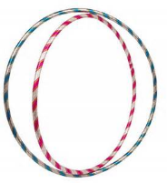
This should be easy right???
There are MULTIPLE agencies that all have a part and aid in youth transitions.
SO WHAT COULD GO WRONG???
There are MULTIPLE agencies that all have a part and aid in youth transitions.

Slide 6


CIL’s Role
Youth Centered and Youth Tooled
Transition plans or blueprints need to match the individuals desires to help them gain the skills and build the relationships necessary for their goals.

Slide 7
CIL Obstacles
Starting Point
Outreach
Multiple Agency Nightmares
Funding
Manpower
Plan

Slide 8
Starting Point
What is your individual CIL’s mission in Youth Transitions?
Blueprint or plan; perhaps mission!
Leader
Delegate
Gather Intelligence

Slide 9
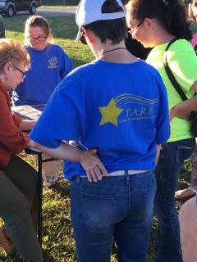
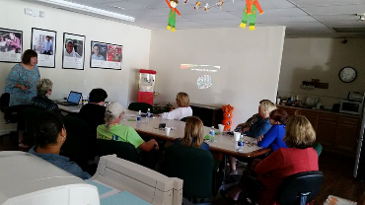
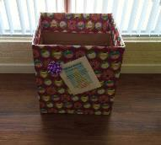
Outreach
Recreational Activities birth stars.
Collaborate with other agencies and coalitions.
Join forces with the schools.
Design flyers for public places.
Get involved with the community.

Slide 10
Multiple Agency Collaboration
Remember focus is changing.
Coalitions
State Agencies
VR
Schools

Slide 11
Funding
Grants
Private donations
Fundraising

Slide 12
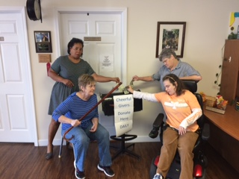
We give our time, treasures, and talents.

Slide 13
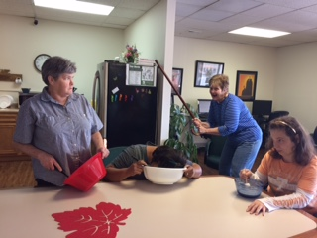
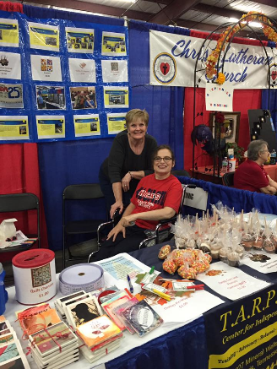
We are creative, industrious, and cost effective.

Slide 14
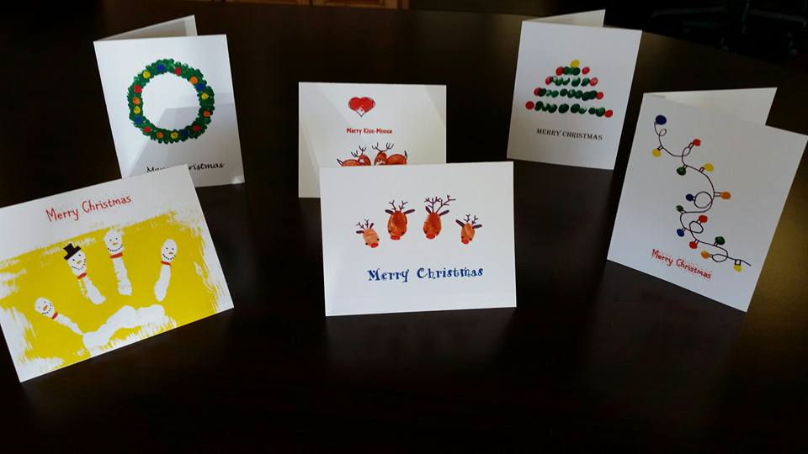
Consumer Involvement

Slide 15
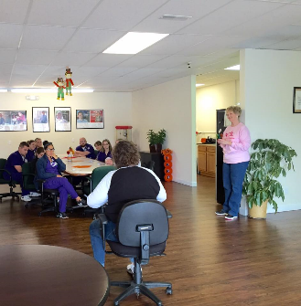
Manpower
Blueprint needs to fit manpower
Utilize volunteers
Utilize the community

Slide 16

Plan
TARP’s mission was to get into the schools
Collaboration
Curriculum
Funding
Community involvement

Slide 17
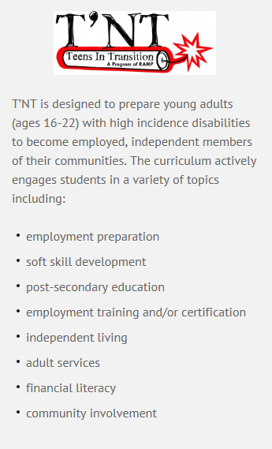
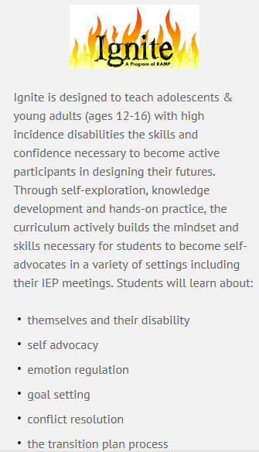
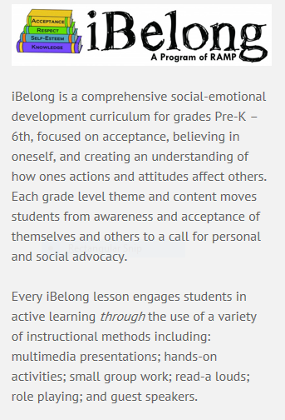
* PLUG our curriculum RAMP CIL

Slide 18
Workshop Time
Obstacles you are facing with Youth Transitions
Obstacles with multiple agency interaction
Obstacles with funding
Obstacles in CIL manpower and blueprints

Slide 19
We need to come together.
Rural CIL with 8 counties that cover 3,903 square miles.
Population is 366,745 with a disability rate of 24%
88,018 people in our area.

