Slide 1


Slide 2
Stick it to Stigma: Embrace, Educate, Equalize is a grassroots advocacy campaign initiated by Arizona Youth Leadership Forum (AZYLF) for Students and Transitioning Young Adults Who Have Disabilities.

Slide 3
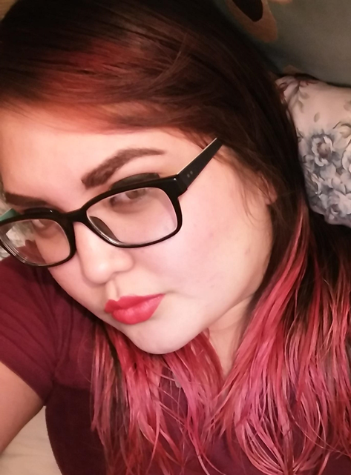
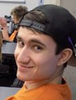
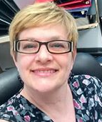
That’s Us!
Anya
Class of 2014
Kevin
Class of 2015
Melissa
Outclassed

Slide 4
Arizona Youth Leadership Forum (AZYLF) for Students and Transitioning Young Adults Who Have Disabilities is an innovative, 6-day conference, for students and young adults who have disabilities, as they prepare for and experience transition to adulthood.
Designed to foster personal growth through self-discovery, AZYLF provides experiential learning opportunities to assist each individual as they identify and embrace their strengths and gifts, in conjunction with planning for their future.
This dynamic environment focuses on leadership development, career exploration, effective advocacy, and empowers through heightened awareness of disability history and culture. Although purposeful and relevant, the true value of AZYLF is not found in a workbook or in the words of an accomplished presenter, it is found in the climate of trust, mutual respect, and absolute acceptance, which allow youth to be themselves, to be heard, and to be changed.
AZYLF has graduated 63 youth from across Arizona, in 2014, 2015, and 2016 combined. AZYLF strives to recruit youth who represent the culture and diversity of Arizona in every way, which enriches the experience and impact for all. AZYLF embraces and employs optimal learning strategies, strength based mentoring, and Person Centered Planning.
AZYLF invests in our most precious resource, the youth who will transform our tomorrows.

Slide 5
What is Stigma???

Slide 6
Brainstorming During APRIL Conference Session:
Misconceptions Unfair views
Pre-judgements Discrediting opinions
Prejudice Unbeneficial beliefs
Discrimination Bias
Disgrace Negative stereotypes
Misguided beliefs

Slide 7
Stigma Defined:
a set of negative and often unfair beliefs that a society or group of people have about something
a mark of shame or discredit
a mark of disgrace associated with a particular circumstance, quality, or person

Slide 8

Stick it to Stigma asserts that in order to reduce the prevalence and resulting harm of multiple and complex stigma, people must embrace, educate, and equalize.

Slide 9
What is multiple and complex stigma???

Slide 10
Brainstorming During APRIL Conference Session:
Multiple issues that are stigmatized
Conflicting stereotypes
Intersectionalities – multiple identities that have associated stigmas
Combination of negative descriminators

Slide 11
Multiple and Complex Stigma Defined:
a combination of innate or acquired attributes or affiliations that are perceived unfavorably, simply because they exist
Melissa Ann Santora, 2016

Slide 12
How are people harmed by Multiple and Complex Stigma?

Slide 13
Brainstorming During APRIL Conference Session:
suicide depression resentments
Employment negative feelings lawsuits
Education self-esteem social acceptance
communication identity loss bullying
Healthcare self harm peer pressure
prejudice cultural differences lack of/loss of support

Slide 14
Where do you see evidence of this harm in your life? In your work? In your community? In our world?

Slide 15
Brainstorming During APRIL Conference Session:
Schools/teachers/Administrators/Universities/Accommodations
Family/friends rural areas
Work/interviews transportation
Healthcare assumptions with levels of independence
Relationships time not valued
Church lack of universal design/accessibility
Community minimal accommodations
Police/Emergency responders lack of flexibility in systems
Media/social media Elections
Self-stigma Government
Stores language barriers
Cultures lack of training/knowledge about diversity

Slide 16
How do we reduce the prevalence and resulting harm of Multiple and Complex Stigma???

Slide 17
EMBRACE
EDUCATE
EQUALIZE

Slide 18
Brainstorming During APRIL Conference Session:
Embrace?
Yourself Understand your disability
Understand your disability is a part of who you are
Recognize and accept all diversities within yourself and those around you
Advocate for yourself
Be the leader of your life

Slide 19
Brainstorming During APRIL Conference Session:
Educate?
Yourself Family Friends
Schools Elected officials
Anyone who will listen when it’s appropriate to do so
Advocate for yourself and others by educating when placed in a situation that compels you

Slide 20
Brainstorming During APRIL Conference Session:
Equalize?
Be a role model share your experience/expertise
Take leadership roles stand up for your self and others
Exercise your Rights be fair and reward fairness
Vote look for opportunities to use your voice
Take surveys/participate in giving feedback on rules and decisions

Slide 21

Stick it to Stigma Pledge:
I, ________________________, agree to openly and actively:
Embrace diversity within myself and others.
Educate myself and others about the strengths and gifts that are inherent within me and within those I encounter.
Equalize myself and others by suspending judgment, demystifying stereotypes, and creating opportunities for acceptance and objectivity in all that I endeavor to be and do.
I join the effort to Stick it to Stigma: __________________________
Signature City, State

Slide 22
2017 Stick it to Stigma Goal
Goal Statement:
Objective:
Objective:
Objective:
Goal: a broad statement about a long-term desired outcome.
Objective: a measurable result that will be achieved in a specific timeframe to help accomplish a desired goal.

Slide 23

Arizona Statewide Independent Living Council
5025 E Washington St #214
Phoenix AZ 85034
602-262-2900
melissa@azsilc.org
www.azylf.org
Check us out: www.facebook.com/AZYLF

