Slide 1

Online engagement
Brittany Hepler, Dayle McIntosh Center Anaheim, California
Tannis Hargrove, Healthy Community Living & RTC:Rural University of Montana
APRIL Pre-conference 2016
Notes:
T 1-7[4:02] B 8-11[4:02] T 12[4:02] B 13-15[4:02] T&B 16[4:02] T 17?[4:02] B 18-22[4:02] T 23

Slide 2
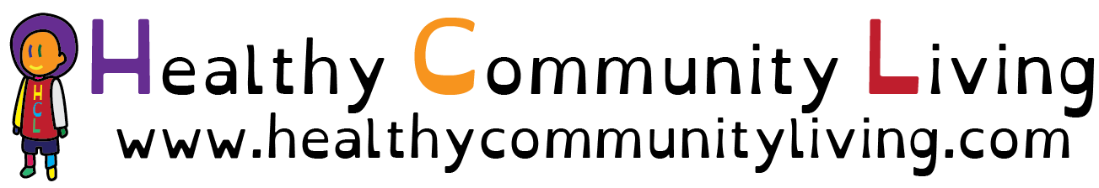
Acknowledgements
Our travel expenses and this presentation are funded through the Healthy Community Living project ,by the National Institute on Disability, Independent Living and Rehabilitation Research (NIDILRR), Grant number 90RT50250100.
To learn more about the Healthy Community Living project specifically please visit our website www.healthycommunityliving.com

Slide 3
Online Engagement Overview
What is online engagement?
Why is online engagement important for your CIL?
What does online engagement look like at your CIL?
Setting up for Success
Resources available following this presentation

Slide 4
What is Online Engagement?
Group Brainstorming:
What does online engagement mean to you?
What do you think of when you hear the words online engagement?

Slide 5
What Did Consumers Say?
Our partners interviewed 25 consumers about online engagement and social media
What did consumers say?
  “It’s a place to where people can talk and group without having to travel.”
  “Social media gives PWD an outlet to communicate without any stigma.”
  A way to connect with your children or learn more about them.
  A way to connect with others and stay connected to friend or family.
  To stay in contact touch with news and current events, to stay in touch with family, or other groups they are interested in
  Job seeking
  Dating, or finding peers your age (across age groups)
  To remain active in the community
  To help gain confidence through “likes” on social media

Slide 6
Online Engagement Defined
Online engagement means different things to different people
According to the Duffy Agency (2016), Engagement is the online catalyst that converts prospects to customers, customers to loyal customers and loyal customers to vocal brand advocates.
What does that mean?
  You can gain consumers who may not know about you through a google search, they may come to your center because they read about your services on your website or Facebook page, and then those consumers have a lot of potential to get involved in the disability community and your CIL.

Slide 7
Why online engagement?
Brittany from Dayle McIntoch Center in Anaheim, California
Speaking about her Center’s experience with rebranding and working to engage consumers online
You can engage consumers online with:
  Website
  Social Media (Facebook, Twitter are the most common)
  Appropriate Branding & considering a logo

Slide 8
Why commit to online engagement?
The Dayle McIntosh Center chose to rebrand and to boost their online presence for several reasons including:
  Visibility
  Be competitive (Everyone else is doing it!)
  Increased funding and access to funders
  Branding should be representative of services

Slide 9
Visibility
We have often been told that our center is the “best kept secret”
Although it is always a nice feeling to be call “the best” we do not want to be a secret
Building a strong online presence allows people to gain access easily
It also helps them identify if your CIL offers the services they are looking for, without having to visit your CIL which can be challenging

Slide 10
Everyone else is doing it!
Though peer pressure is not always a good thing you can also learn a lot from your peers
We want to be competitive and on an equal playing ground with other agencies

Slide 11
Funders & Funding
If your CIL applies for community based grants or other private grants with funders ALWAYS want to see the website and learn more about your organization
An engaging web presence could help you gain a needed edge with a funder or private donor
This allows you to put your best foot forward every time
The website allows your CIL to demonstrate what you do best!

Slide 12
Logos & Branding
What’s in a logo?
Logos help members of your community identify you quickly and easily
The goal of a logo is to help promote instant public recognition and association with the services you provide
It’s like putting your stamp on your work, materials and online presence
It makes it easy to identify you whether you are online or at an outreach event in the community
Notes:
Tannis

Slide 13
Challenges: Logos & Branding
Representing all the services you offer can be challenging
Representing the work you do can be very challenging
Representing your work across disability can be very challenging
Asking consumers and CIL staff can lead to conflicting feedback

Slide 14

Logo BEFORE Rebranding

Slide 15

Logo AFTER Rebranding

Slide 16
What Does Online Engagement Look Like at Your Center?
Pull out your notebooks & a pen
Please jot down the answers to the following questions
QUESTIONS:
What online tools does your center currently have? (examples website, social media page, linked in account, etc.)
Does your center currently have a strategy for online engagement?
  What are the strengths of the strategy?
  What are the weaknesses of the strategy?
Do you have staff dedicated to online tools?
Notes:
Tannis facilitate – Brittany will write down items as they are called out

Slide 17
Setting Yourself Up for Success
Know Your Audience
  Consider your consumer base
  Who is likely to search online for your center
  What is the community you are within like?
  How do consumers find you now?
Notes:
Tannis – audience participation

Slide 18
Setting Yourself Up for Success
How do consumers find your center online?
What online resources does your center have available?
Are the up to date, user friendly and accessible?
  Website Layout
  Look & Feel – color, limiting descriptions
  Types of photos – real people vs. stock photos
  Tying your social media accounts to your website – they should compliment each other

Slide 19
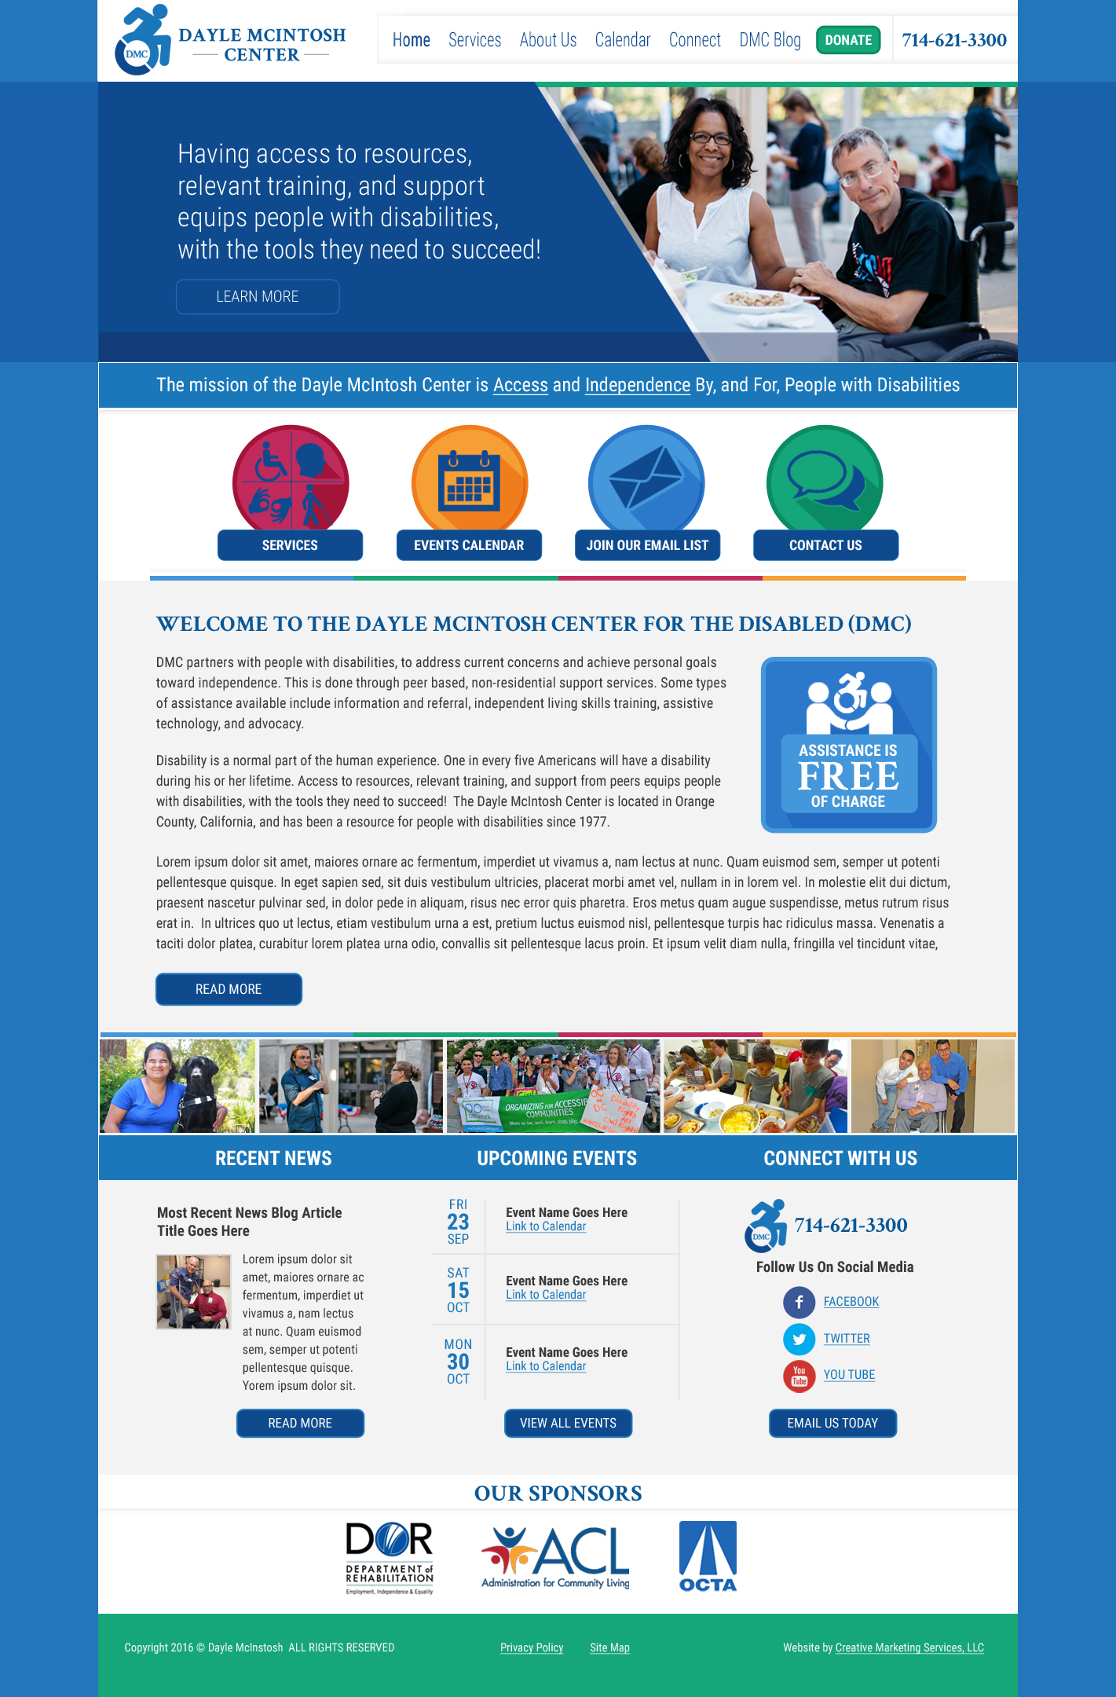
Setting Yourself Up for Success

Slide 20
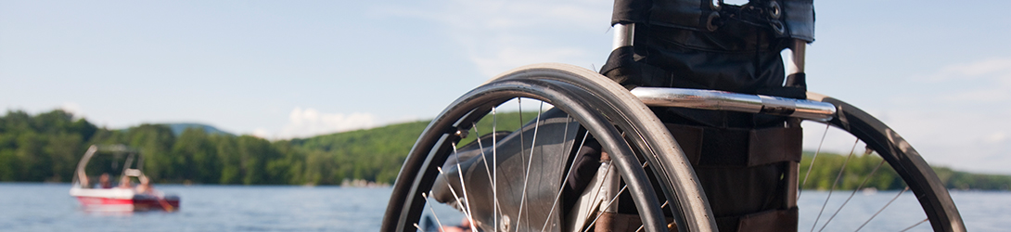

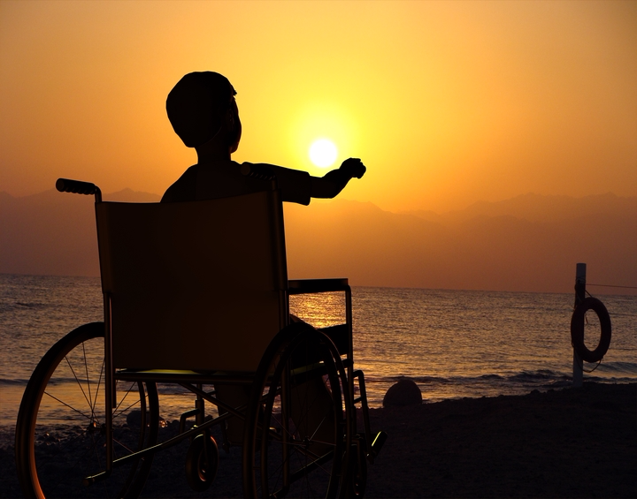

Stock Photos
Notes:
Tannis speak about these

Slide 21
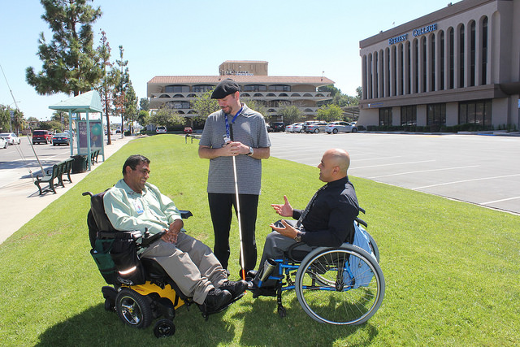
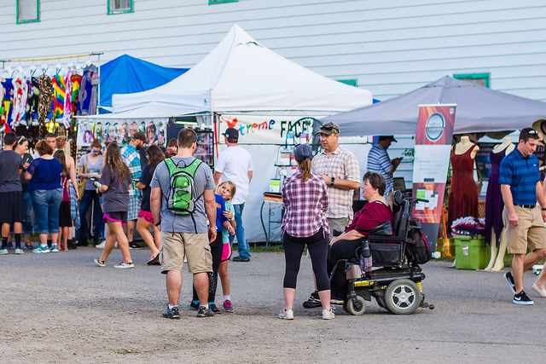
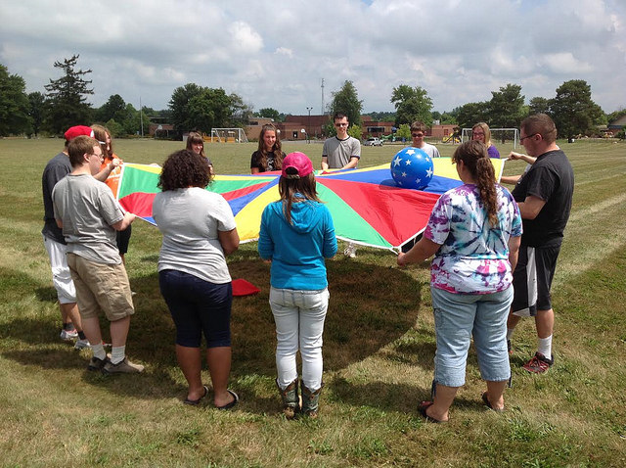
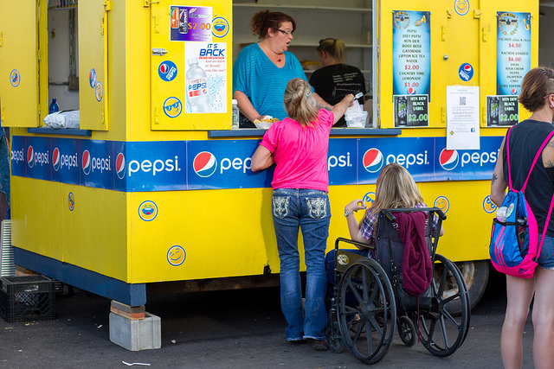
Real People in Real Life
Notes:
Tannis speak about these.

Slide 22
Search Optimization
Can your consumers find your center online?
If you were going to search for your center what words would you use?
Searching for a center can be very challenging
Is can be difficult to know what terms to use in a search
Community members might not find you because they are using the wrong search terms

Slide 23
Resources on the APRIL Website for Online Engagement
RTC: Rural online guiding principles document (feel free to adapt for your center)
Independence First online policy (feel free to adapt for your center)
Photo Release Document (feel free to adapt for your center)
Search Terms Document
Notes:
Tannis

