Slide 1
Enhance Your IL Services
Online
Technology Paving the Way for Service Delivery

Slide 2
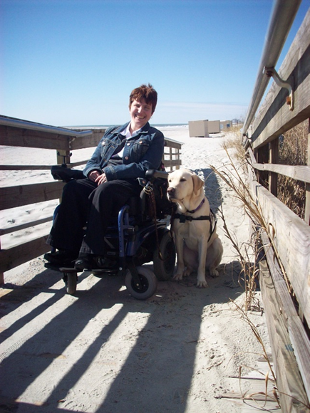

Dori Tempio,
Community Outreach and Consumer Rights Coordinator
136 Stonemark Lane; Suite 100
Columbia, SC 29210
803-779-5121; extension 126
Toll Free: 800-681-6805
TTY: 803-779-0949
E-mail: dtempio@able-sc.org
Visit us online at www.able-sc.org

Slide 3
Ice-breaker
Share your name and one piece of technology or app you can’t live without.
Notes:
Dori and my cell phone…..have people share name, their agency or CIL, and technology.

Slide 4
Challenges In Providing Core IL Services To Consumers In Rural Areas
Peer Support
Advocacy
I&R
IL Skills
Transition
Notes:
Ask and List

Slide 5
ACTIVITY
    Brainstorm in groups of two or three the challenges your CIL and staff face when providing IL Services in rural areas and write responses on giant post-it note chart paper.

Slide 6
How Can We Take These Challenges and Turn Them Into Opportunities?
Notes:
Have volunteers share their challenges and discuss the opportunities that can evolve. EX: Not able to travel- Use skype for one-one-discussion.

Slide 7
Options for Working With Consumers Online

Slide 8
Independent Living Skills

Slide 9
What Are Some Goals Your Consumers Want to Achieve?
Notes:
Ask participants- Setting goals can make a difference in our lives and we all have goals, even if we do not recognize them. For example, suppose you want to go out with a friend to dinner this week. That is a goal. You have decided to do something in the future and will need to complete small steps along the way to accomplish this goal. Steps could include checking with the person that you want to eat with to see if they are available, decide where to eat, arrange transportation and budget for the expense.

Slide 10
Goal Setting
Notes:
When consumers set their own goals, there is always more success! Lifetick is one useful tool to accomplish goal setting with consumers via computer or smartphone.

Slide 11
Ascertaining Topics for Independent Living Skills Needed
https://www.surveymonkey.com/
Notes:
You can develop a simple survey online using tools like Survey Monkey where you can ask questions about skills consumers are interested in learning. And, e-mail to consumers for seeking interest

Slide 12
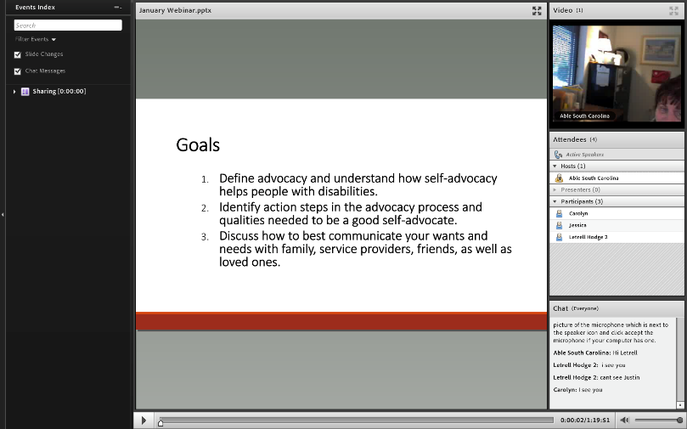
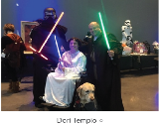
Teaching IL Skills In Groups Via Webinar
Notes:
At Able SC we offer both in-person as well as online independent living skills using the Adobe Connect Webinar Platform once a month. The topics are generated by consumers and IL Staff. We record and archive them on our website for any consumer to view at anytime . http://www.able-sc.org/get-involved/join-our-team/trainings-events/ and http://www.able-sc.org/resources/

Slide 13
One-On-One Implementation of IL Skills
Notes:
Using onlne platforms like Skype, FaceTime, Facebook messages, webinar portal
, allow us to work one-on-one with consumers on skills like self-advocacy, interviewing skills, and negotiating reasonable accommodations. Ask: How else could you/or have you use(d) it with consumers?

Slide 14
Empower Hour & EQUIP Hangout
Participants serve as motivators and role models, as only someone with personal experience with disabilities can do.
They share life experience and bring new ideas and information to facilitate independence.
They work one-on-one, in small groups and do regular monthly Peer Support Groups for those interested—both on site and online.

Slide 15

Impact of Empower Hour Online
Notes:
Ebony is a consumer with a developmental disability who lives in a small town, in rural SC. She has minimal access to services. She joined Empower Hour online five years ago. When she first started, she was very soft-spoken, and did not advocate for herself. Now, she serves on the board of Impact SC, Person-Centered Planning Committee, DHHS, a volunteer with the Red Cross, and a recent graduate of CLA. All of this is done online through various platforms.

Slide 16
Advocacy-Community Leadership Academy
Notes:
The USC School of Public Health has funded an effort to increase participation of individuals with disabilities on boards, committees, and councils. In its commitment to ensure the individuals have the tools and resources necessary to effectively participate in a leadership role, the course teaches skills such as professional dress, ethical and legal responsibilities, and Robert’s Rules of Order. Taught in person and online webinar.

Slide 17
Community Leadership Academy
Video
Notes:
https://www.youtube.com/watch?v=33C1uLDSUUc&feature=youtu.be – Show Video

Slide 18


Transition
  This would be very similar to the strategies for adults (skype, email, allowing a phone conference option, GoToMeeting or AdobeConnect)
  We also use pre-created videos to share when young adults can’t share their message in person (The Same)
Notes:
Show video. https://www.youtube.com/watch?v=YhsjX9veRP8

Slide 19
Methods for Connecting Consumers to Services

Slide 20
Strategies
E-blasts
E-mails
Letters
Phone Calls
Flyers
Outreach
Consumer Word of Mouth
Facebook, Twitter, Instagram, Able SC Website

Slide 21
How would you like to use online service delivery at your CIL?
ACTIVITY
Notes:
Get in groups of two or three and make a list to share with the group…..list. 10-15 min. Then, ask what are some barriers you may encounter?

Slide 22
Brainstorm and Discuss Solutions as a Group
Notes:
Share a few ideas/examples and share solutions as a group.

Slide 23
Thought to Ponder
“The only way to discover the limits of the possible is to go beyond them into the impossible.” Arthur C. Clarke (1917 )

Slide 24




Keep up with Able SC on

Slide 25
Questions
?

