Slide 1
Social Media and CILs
Kim Gibson and Danny Housley
APRIL 2016

Slide 2
What is Social Media?
An online resource that people use to connect with one another
Can be used for promotion and advocacy purposes
Has grown tremendously over the years
Accessibility has been a major concern

Slide 3
How is it Used?
Personally
Professionally
Mixed

Slide 4
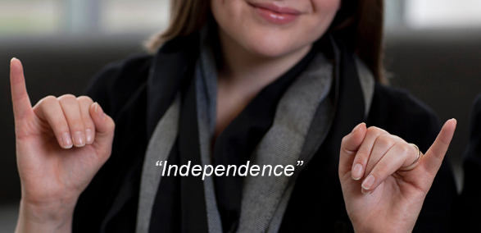
How is it Used in a CIL?
Outreach
Networking
Peer Support
Advocacy
Education
Information and Referral

Slide 5




Slide 6
Facebook
Great for engagement
Know your audience
We post articles centered around disability rights
Type of post varies depending on the algorithm
Exposure can be linked to post frequency and audience
Type | Average | Description
Daily total impressions | 187 | The number of impressions seen of any content associated with your Page. (Total Count)
Weekly total impressions | 327 | The number of impressions seen of any content associated with your Page. (Total Count)
Daily total reach | 47 | The number of people who have seen any content associated with your Page.

Slide 7
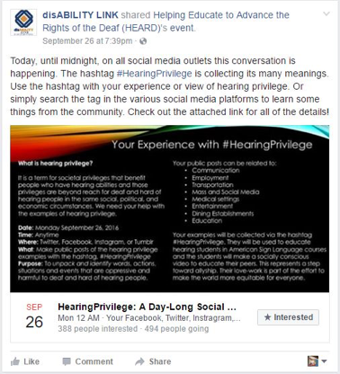

Slide 8
Twitter
Great for networking as an organization
Social engagement is maximized with this
Can post as much as you like
Use Hashtags to maximize reach
Most people reached was 500,000

Slide 9
Professional Social Media
LinkedIn
MailChimp
Engage with groups focused on IL/Social Media/Disability Rights
Recruit talent
Strengthen brand
Professional networking
Used for direct mailings to consumers
Weekly newsletter
Some limitations
Makes distribution lists easy

Slide 10
Best Practices:
Always Have a Plan

Slide 11
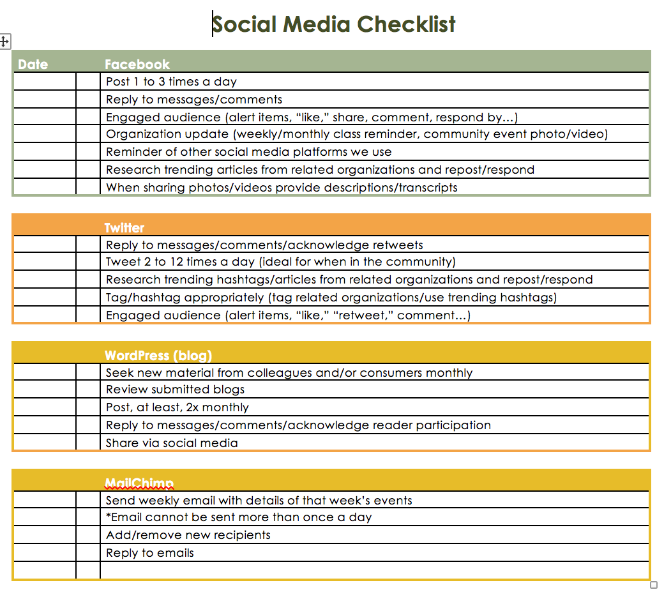

Slide 12
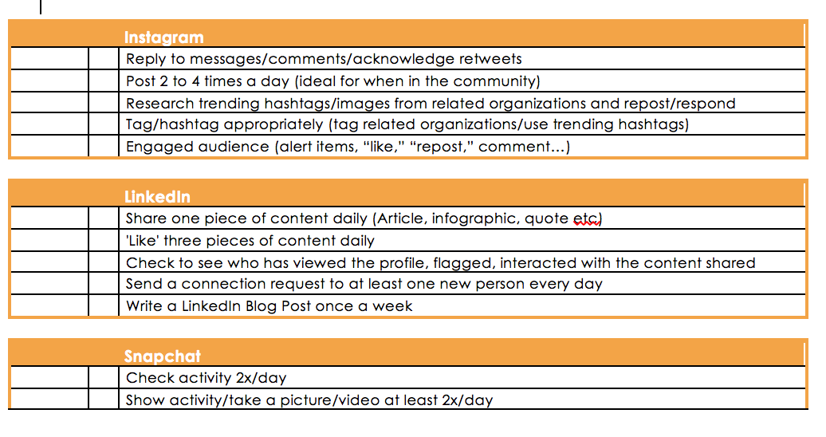

Slide 13
Social Media Playbook
Your plan for the future and your metrics from the past
You should map out a strategy for each social media outlet
Include statistics to view trends and year-over-year growth
This can alter how you post for maximum exposure

Slide 14
Any Questions?
Thank You!

Slide 15
Find disABILITY LINK Online
Web: www.disABILITYLINK.ORG
Facebook: www.facebook.com/disABILITYLINK
Twitter: www.twitter.com/disABILITYLINK
Instagram: www.instagram.com/disABILITYLINK

Slide 16

For More Information
Phone: (404) 687-8890
Video Phone: (404) 381-8117
Fax: 404-687-8298
1901 Montreal Rd
Suite 102
Tucker, GA 30084

