Slide 1
“When you have nothing….you have nothing to lose”
Building a PROCESS for a Methodology in Determining Base Funding
Prepared by
Joan LaBelle
W. Kirt Toombs, MMDS

Slide 2
AGENDA
Our Common Core Principle
Past and Future Oregon PROCESS Methodologies for Determining CIL Base Funding (the “Why - Why” Tool)
Independent Living System Standards for U.S. Centers for Independent Living – Methodology for Determining Base Funding
How One State Successfully Advocated for State IL Dollars
Conclusion/Discussion

Slide 3
Our Common Core Principle
We know our role in this global IL movement and we have faith in our own voices
Together we define and advance our IL movement.
This is our movement, our history, our struggle, our global family with disabilities being institutionalized, experiencing rights infractions, experiencing homelessness, being abused, living in poverty, and dying.
We believe in our abilities and rights as PWDs to exercise control over our lives
We are valuable! We will speak up! We will be heard! We will make change happen! We will not quit!

Slide 4
We MUST advance the
Independent Living Movement

Slide 5
Past and Future Oregon PROCESS Methodologies for Determining CIL Base Funding (the “Why - Why” Tool)
“The more the plans fail, the more the planners plan…”
Methodology for Determining Base Funding

Slide 6
Institute for Disability Studies and Policy
Methodology for Determining Centers for Independent Living Base Funding
Population PWD
Determine Target Population % To Be Served
Determine Statewide CIL Direct/System Advocacy %
Determine Hours of Direct Service Required Per Consumer
Determine Livable Wages
Determine How Many Employees are Required Statewide
Determine Number of Employees for Each CIL
Determine SPIL Section 3: Design for Statewide Network of Centers – Base CIL Funding Levels

Slide 7
STEPS 1-3
STEP ONE:
Population PWD 511,280 – Noninstitutionalized
STEP TWO:
Determine Target Population % To Be Served 2.5% = 12,782
STEP THREE:
Determine Statewide CIL Direct/System Advocacy/Other %
    40/40/20 (832 hrs./832 hrs./416 hrs. = 2080 hrs.)
    55/25/20 (1144 hrs./520 hrs./416 hrs.=2080 hrs.)
    45/45/10 (936 hrs./936 hrs./208 hrs. = 2080 hrs.)
    80/10/10 (1664 hrs./208 hrs./208 hrs. = 2080 hrs.)

Slide 8
STEPS 4-6
STEP FOUR:
Determine Hours of Direct Service Required Per Consumer (1-4 hrs)
STEP FIVE:
Determine Livable Wages (MIT Livable Wage – Oregon: $52,629.00
(http://livingwage.mit.edu)
STEP SIX
Determine How Many Direct Service Employees are Required Statewide and Direct Service Budget

Slide 9
STEP SIX
2.5% PWDs Population | Average Hours | Total Hrs. Required | 80/10/10 | Statewide FTE Required | Total Statewide Cost of CIL Services
12782 | 4 | 51128 | 1664 | 31 | $1,631,499.00
12782 | 9 | 115038 | 1664 | 70 | $3,684,030.00
12782 | 15 | 191730 | 1664 | 116 | $6,104,964.00
Notes:
12782 multiply by 4 equals 51128 divide by 1664 equals 31

Slide 10
STEPS 7-8
STEP SEVEN:
Determine Number of Employees for Each CIL
STEP EIGHT:
Determine Annual Statewide and Individual CIL IL Budgets to Meet Objectives

Slide 11
STEP SEVEN
CIL (511280) | % of PWD X PWD per Co X 2.5% (661) X 4 (number of hrs/person) / by 1664 (80/80/10) | FTE 2.5% - 4 Hrs. (80/10/10 Model)
ABILITREE | 5.17% (26,433) | 2
EOCIL | 5.47% | 3
HASL | 9.01% | 4
ILR | 36.25% | 14
LILA | 10.06% | 5
SPOKES | 2.56% | 1
UVDN | 4.47% | 2
 | 73% | 31
Notes:
Take 511,280 (total statewide PWD), multiply by percentage of PWD in county, multiply by the 2.5%, multiply by hours, divide by 1664 (80/10/10 standard)

Slide 12
STEP EIGHT
Abilitree | (Wages 60%) $105,258 (FTE) $156,273 (Director) $111,120 (Assistant Director) $44,081 (Office Support) (Indirect & Direct 40%) $166,693.00 Total $583,425.00
EOCIL | $657,106.00
HASL | $730,786.00
ILR | $1,467,592.00
LILA | $804,467.00
SPOKES | $509,745.00
UVDN | $583,425.00
Total IL Base Funding | 5,336,446.00

Slide 13
DIFFERENCE BETWEEN CURRENT AND REQUIRED
CIL | Current Base Funding (Part B ,C and State General Funds) | Required Base Funding | Funding Advocacy
Abilitree | $250,000 | $583,425 | $(333,425)
EOCIL | $250,000 | $657,106 | $(407,106)
HASL | $250,000 | $730,786 | $(480,786)
ILR | $439,413 | $1,467,592 | $(1,028,179)
LILA | $250,000 | $804,467 | $(554,467)
SPOKES | $250,000 | $509,745 | $(259,745)
UVDN | $250,000 | $583,425 | $(333,425)
Total | $1,939,413 | $5,336,546 | $(3,397,133)

Slide 14
STEP EIGHT
Expandng Unserved/Under-served
PWD Population ex. of Marion Co. (8%) | 40,000
PWD to be Served Using 2.5% Standard | $1,000
Using 4 hours Average Time of Services | 4,000 hours
*80/10/10 Standard (1,664) | 3 FTE @ $52,629.00 = $157,887.00
Director | $156,273.00
Assistant Director | $111,120.00
Office Support | $44,081.00
Sub-Total | $469,361.00
40% Indirect/Direct Standard | $187,745.00
Total Required for Expansion | $657,106.00
* For opening a CIL that is targeting unserved/underserved the formula should utilize 40/40/20

Slide 15
COLORADO’S EXAMPLE

Slide 16
Colorado
2009 – Attempts at paradigm shift
2013-14 – Lobbyist and Joint Budget Committee

Slide 17
SB-240-Allocate general funds….
The general assembly recognizes omissions in the delivery of independent living services to individuals with disabilities and desires to remedy such inadequacies in the delivery
system through services at the community level. The general assembly finds that independent living centers pave the pathways to full participation in professional and community life for all individuals with disabilities. To advance and support the independence of individuals with disabilities and to assist those individuals to live outside of institutions, the general assembly hereby enacts this article.

Slide 18
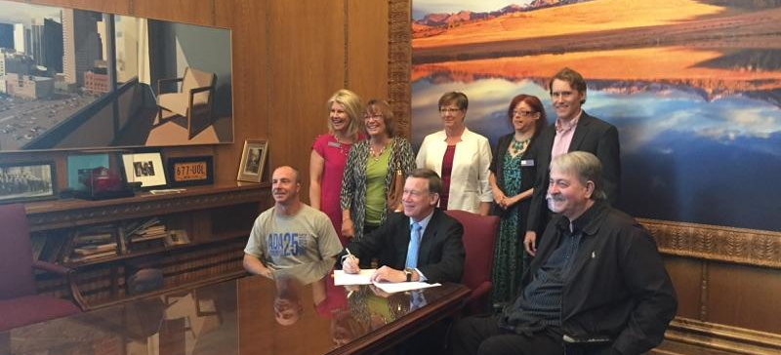
Governor John Hickenlooper signing SB93

Slide 19
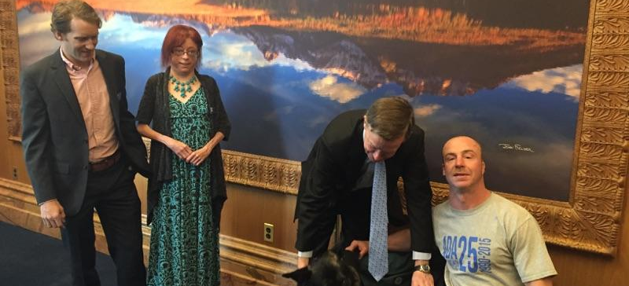
Distracted by Zuma

Slide 20
Colorado
SB 93- Transfer of oversight of IL Services from Colorado Department of Health and Human Services to Colorado Department of Labor and Employment
Consensus
$600,000 base, plus formula

Slide 21
Recommendations
1. BELIEVE THAT YOU ARE WORTH IT!
2. If you don’t have a state Association, start one.
3. Research and Develop a “Why, Why. Why” chart to be able to treat the root cause
4. Run the formula for your state (available on Amazon under U.S. CIL base funding methodology or contact Kirt Toombs)
5. Get it in your SPIL (either an amendment or next SPIL cycle)
6. Share your state’s developed formula with NCIL and APRIL
7. Live by the Core Principles
8. Be ready for the battle

Slide 22
QUESTIONS/COMMENTS

Slide 23
“If we are inclusive, open-minded, cohesive, transparent, never stop moving forward, and do not give up, we will change the world”

