Slide 1

Accessible Social Media
Danny Housley

Slide 2
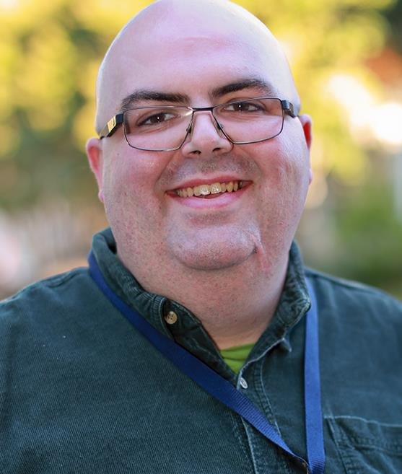
About Your Presenter
AT Funding and Resource Specialist with Tools for Life
Formerly AT and Social Media Specialist at disABILITY LINK in Atlanta
Worked at the CIL for 5 Years
Lifelong advocate
Avid social media user

Slide 3
Accessibility in Social Media
Easier now than it used to be
Invest in your content and invest in your followers
Get to the important points
It is YOUR responsibility

Slide 4
Don’t Panic

Slide 5
Video

Slide 6
Video Best Practices
Captions
ASL Interpretation
Audio Description
Avoiding Flashing/Strobing Imagery

Slide 7
Guidelines for Captioning
Required for most media (a transcript can be provided for audio only items like conference calls)
Captions are text synchronized with the video
YouTube has made this very easy (wasn’t always the case)
To “burn in” or not to “burn in?”

Slide 8
Remember:
Captions are useful for many people with and without hearing related disabilities

Slide 9
More Captioning Tips
Think about placement on the video
Transparency
Contrast
Font- sans serif, avoid bold and italicized text

Slide 10
Audio Description Best Practices
Don’t over describe
Use “quiet moments”
Be objective
“Talking head” videos don’t need audio description
Names and images should be described
Text doesn’t need description as long as it’s included in the speech

Slide 11
Audio Description + Captioning
https://www.youtube.com/watch?v=SPoVZtoVbOo

Slide 12
Audio Description
https://www.youtube.com/watch?v=O7j4_aP8dWA

Slide 13
Tools for Media Creation
iMovie
Adobe Primere
Final Cut Pro
YouTube App
Skill levels vary

Slide 14
Just Remember:

Slide 15
General Tips
Videos can be easy to edit with the right tools
Start small
Make a transcript of any audio
Use YouTube for quick and easy captioning
Audio descriptions can be added as an extra sound track easily
Don’t be afraid to outsource, if the price is right

Slide 16
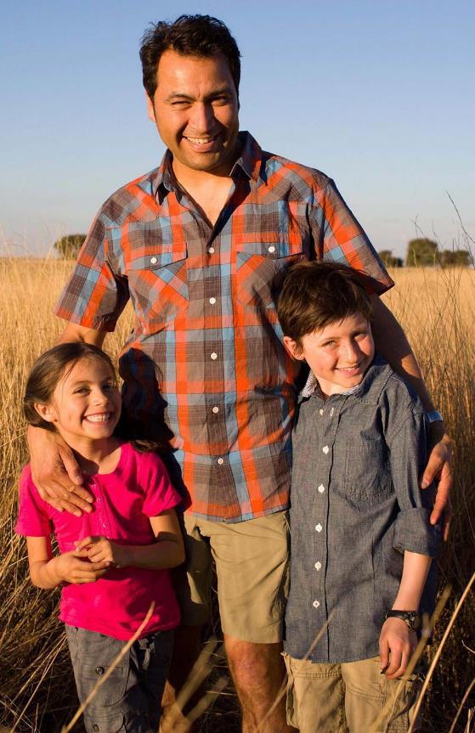
Pop Quiz!

Slide 17
Question 1
Is sign language required for video accessibility?

Slide 18
Question 2
Can I post the video and have other people transcribe it for me?

Slide 19
Question 3
Should my audio description run the entire video?

Slide 20
Resources and Standards
World Wide Web Consortium
  https://www.w3.org
Web Content Accessibility Guidelines
  https://www.w3.org/TR/WCAG20/
AMAC Accessibility Solutions and Research Center
  http://www.amacusg.org

Slide 21
Other (Accessible) Social Media

Slide 22
Facebook
1.13 billion people log in daily
Many posts are images with no description
Automatic alt-tagging came out this year
Mobile version is easier to navigate than browser version
Takes trial and error to get it “right”
Exposure varies based on the algorithm

Slide 23
Facebook Best Practices
Don’t post videos that are uncaptioned
Add image descriptions at the bottom of your post
Don’t post too much
Experiment and use the analytics tools at your disposal
Facebook Live can be problematic with accessibility

Slide 24
Twitter
Easy to navigate with a screen reader
Post as much as you like
Posts are generally accessible, linked items can be problematic
Be sure to respond and interact with your followers

Slide 25
Instagram
Mostly images, videos of up to 60 seconds
There is currently no way of adding captions, transcribe spoken work in the description
Great way to share messages in ASL
Images MUST be described for non-visual users

Slide 26
Snapchat
Images and 10 second videos
Can make a “story”
Accessibility can be problematic
No way of adding descriptions, captions or other alternate access

Slide 27
Wordpress
Can be very accessible
Built in alt-text that is very easy to use
Remember, if you share a video, be sure it’s accessible
Blog posts are easily accessed visually, or by screen readers for those with print disabilities

Slide 28
How Do I Create Content?

Slide 29

Tools for social media content creation

Slide 30
With the right tools, social media can be accessible for both consumers and creators of content

Slide 31
Questions?
Comments?
Small Jokes?
Thank you!

Slide 32
Contact Me!
Danny Housley
AT Funding and Resource Specialist
Tools for Life
danny.Housley@gatfl.gatech.edu
404-385-7029
www.gatfl.org

