Slide 1
Promoting Positive, Effective, & Authentic SILC Member Engagement - Decentralized Value-Based Teaming & Peer Support
Brooke Wilson - Executive Director Oregon State Independent Living Council
Mikayla McHenry - Kansas Institute for Positive Healthy Inclusive Communities

Slide 2
Complex State Human Service Networks (1 of 2)
Navigation under the best of circumstances:
Federal Governing Statutes
Mandated State Entities, Functions, and Oversight
State Administration Flexibility and Contextual Variables
Regional Administration Flexibility and Contextual Variables
Limited Funds & Waiting Lists for Needed Services
Potential Political Shifts Every 2 to 4 Years

Slide 3
Complex State Human Service Networks (2 of 2)
Examples of Additional Potential Navigation Hazards:
Oversight responsibilities designated without training or commitment
Perception of competing interests amongst stakeholders
Inconsistent messaging regarding advocacy and shared interests
Historical patterns of challenging interactions between stakeholders
Antagonistic vs. Collaboration culture
Limited Consumer led initiatives and discussions
Low stakeholder participation and communication
Leadership does not reflect consumer diversity

Slide 4
Brief History
Oregon’s IL Network consists of:
  7 CILs – 5 Part C and 2 Part B funded – ALL receive State General Fund and Part B dollars
  Oregon SILC
  Oregon Commission for the Blind (OCB)
  Oregon Vocational Rehabilitation serving as the DSE
Notes:
In addition – Oregon has the Association of Oregon Center’s for Independent Living AOCIL – However 3 of CILs are no longer members and during the PET project the AOCIL Executive Director resigned.

Slide 5
What was the issue?
We lacked “T.A.C.T.”
  Trust
  Accountability
  Communication
  Time management
  I used to say if we were more “tactful” our relationships would be better.
A lack of respect and misplaced value
  IL philosophy – “nothing about US without US.”
Notes:
Trust – over time individuals developed a distrust for one another. Individuals held on to events of the past even if the individuals involved had left the IL movement years before.
Accountability – There was a lot of finger pointing – Also limited collaboration between partners – Confusion as to the roles to be played and for those who had multiple roles (which most of us do in this field) confusion as to which role was being filed at any given time.
Communication – Key for healthy relationships. There were processes put in place historically that information went to one person and then was disseminated to others. This was unsuccessful in many ways. And we created lists and everyone gets everything – sometimes multiple times.
Time management – We would hold meetings and not even begin to cover the agenda, people would be aware of deadlines and not share that information with the group or not prioritize the work and become caught in a procrastination, crisis over and over.
What do I mean by a lack of respect and misplaced value? Often times consumer or council member input was not valued. CIL directors were “louder” and consumer and council members placed additional value on CIL directors input than often times even their own. ALL parties are important, ALL statements have value, but for several years consumers and council members were not encouraged to participate in the discussions and when they did it often was overridden by a CIL director comment.

Slide 6

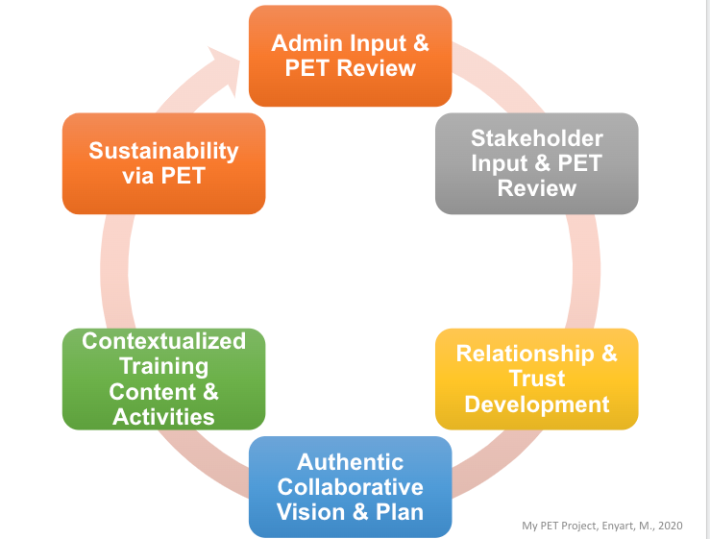
Positive Effective Teaming (PET) Project Process & Features

Slide 7
Admin input and PET review
Inclusion of everyone within the IL Network
Surveys
Interviews provided in person & virtually based on individual requests
Reports to the group while maintaining confidentiality and anonymous responses
Group trainings
Continued inclusion and generous engagement encouragement
Acceptance of past “issues” or the ability to move forward

Slide 8
Stakeholder input and PET review
Self-evaluation tool measures perceptions regarding Positive Effective Teaming features and agreed-upon shared values
Four Domains 25 questions on the survey and open-ended questions
  Consistent and Agreed Upon Expectations
  Conflict Resolution and Collaboration
  Communication, Trust, and Transparency
  Positive Culture and Strengths-Based Interactions
Contextualized training based on scores reflected on the survey

Slide 9
Relationship and trust development
Authentic communication
Validating perception
Comfort with Discomfort
Confidentiality
Respect
Full transparency

Slide 10
Data-based
Opportunities & Action Steps
Opportunity: Clarify & Enhance Shared IL Network Value-Related Expectations
Action Steps
Develop shared IL Network Values
Use PET Positive Practices to: Teach, Reinforce, Provide Constructive Feedback

Slide 11
Authentic collaborative vision and action plan
Be Consumer Led and Emphasize Consumer Choice & Inclusion
Promote Mutual Respect
Culture of Improvement
Coordinated and Collaborative Advocacy

Slide 12
Data-based
Opportunities & Action Steps (1 of 5)
Opportunity: Include IL Network Value Related Expectations in IL Orientation
Action Steps
Consider SILC/IL Network Orientation Information & Processes
Revise with IL Network Input
Pilot with New IL Network Members

Slide 13
Shaping IL Network Values
  Onboarding
  “Board with your best self, leave everything else at the station”
  Share Value Expectations
    Reinforcement
    Constructive feedback
      Giving & responding to feedback
      Responding to triggers
    Reinforcement

Slide 14
Data-based
Opportunities & Action Steps (2 of 5)
Opportunity: Enhance IL Network Knowledge of SILC & CILs
Action Steps
Improve Knowledge of CILs by SILC Staff & Members
Develop & Execute Plan to Expand/Diversify SILC

Slide 15
Contextualized Content & Activities
Positive Practice Example & Activity
  Train
  Reinforce
  Give Constructive Feedback
Constructive Feedback “Teachable Moments”
  Focus on IL Network Shared Values

Slide 16
Constructive Feedback (Teachable Moment) Procedures
Discrete
ASAP
Constructive & Respectful
Objective Focus on Agreed Upon Mission & Vision
Data-Based Follow-Up
Consider What Contributed
Comfort with Discomfort
Practice

Slide 17
Interaction Dynamics
  Professional Group
  Professional individual engagement
  Professional/personal individual engagement
  Virtual meeting
  Email
  Phone call
  In-Person

Slide 18
Data-based
Opportunities & Action Steps (3 of 5)
Opportunity: Address Perceived Concerns Regarding Leadership Roles & Terms
Action Steps
1. Change By-laws to address perceived conflicts with SILC Leadership roles following current terms served.

Slide 19
Data-based
Opportunities & Action Steps (4 of 5)
Opportunity: Promote & Protect Consumer Input
Action Steps
Prioritize Value & Related Expectations with PET Positive Practices
Survey Regularly with Determined Survey Tool & Processes

Slide 20
Avoid Admiring Problems
  Shift to Positive Productive Values
    Remember your health, life is indeed to short
  Be solution focused
  Engage values when no one is looking and when everyone is looking
  Everyone, even leaders, occasionally lose their way. A positive community culture is galvanized when individual and collective members own their missteps and trust that despite personal differences, everyone is earnestly working towards the agreed upon shared values.
  Make space and time for all communication

Slide 21
Data-based
Opportunities & Action Steps (5 of 5)
Opportunity: Sustain IL Network Values
Action Steps
Ongoing Evaluation & Calibration w/ Boosters
Determine Survey Tool & Processes

Slide 22
Sustainability with PET
Evaluation of the PET Features (6 scaled questions)
  Developed from the original survey
Evaluation of Identified Values (4 scaled questions)
  Baseline average score is a four
Perceptions of the IL Network (3 open-ended Questions)
  Please share any experiences from the last three months which positively reflected IL Network Values.
    Collaboration
    Right Path
  Please share any experiences from the last three months which indicate opportunities to improve IL Network Values.
    Minimum Conflicts, But Concerns Regarding Sustainability
    Continue to Strive for Safe Spaces
    A Journey Will Take Time
  Any additional comments regarding PET features and agreed-upon IL Network Values?
    Generally Positive

Slide 23
IL Network Survey Procedures
Facilitated by the SILC using agreed upon accessible online survey tool
Completed every two months for two cycles then IL Network will review process and frequency moving forward
Results of each survey will be shared with IL Network at the next SPIL workgroup meeting
All data will be shared with all IL Network members. However, open ended question responses may be reworded to de-identify specifically named individuals
The IL Network will compare survey data with previous data and discuss alignment with PET skills and IL Network values. Strengths will be reinforced, and action steps will be created for any needs

Slide 24
Improvements we’ve seen and felt
In April of this year, we began working on a legislative request for the 2023 legislative session – CIL Pay Equity
  Meetings took place at least 2x a month (and still do)
  True collaboration
  Tough conversations – funding distribution, staffing needs, rural versus urban
  ALL 7 CILs agreed to the pay standards for ALL staffing within their CIL that is considered an IL funded position
  CILs began sharing information to create a statewide picture
  The Legislative request made it through all the initial steps – further than any request in the past
  Our request WAS included in the Agency recommended budget – ODHS/VR can advocate for this request

Slide 25
SPIL development
A goal within our current (20-23) SPIL is: Funding formula and methodology will be reviewed & updated at least biennially to address service expansion through capacity-building and outreach to unserved IL consumers.
  We have met 5 times this year to discuss Oregon’s funding formula and methodology.
As an IL Network we have also had weekly meetings while developing the upcoming SPIL for 2023-2025.
  Discussing Section 3.2 – Network expansion

Slide 26
Contact us with any Questions!
Mikayla McHenry
Brooke Wilson

